Slide 1
Drink & Delight
Inventory Management Improvement System

Slide 2
TEAM C
ASTHA
PULAK SINHA
SAGAR SHARMA
SHIVAM TEWARI
TANISHA SINGH

Slide 3
EPIC & User Stories
EPIC 1: Raw Material Inventory Management:
User story 1: Collect raw material details
User story 2: Add raw material
User story 3: Update raw material details
User story 4: Search raw material by name
User story 5: Search raw material by id
User story 6: Delete raw material
User story 7: Get list of all raw materials

Slide 4
EPIC & User Stories(Contd.)
EPIC 2: Raw Material Order Management:
User story 1: Collect requirements for each raw material
User story 2: Generate order ID
User story 3: Consolidate order details to form an order and calculate expenses on the order
User story 4: Search order by order id
User story 5: Get a list of all orders
User story 6: Update an order
User story 7: Delete an order

Slide 5
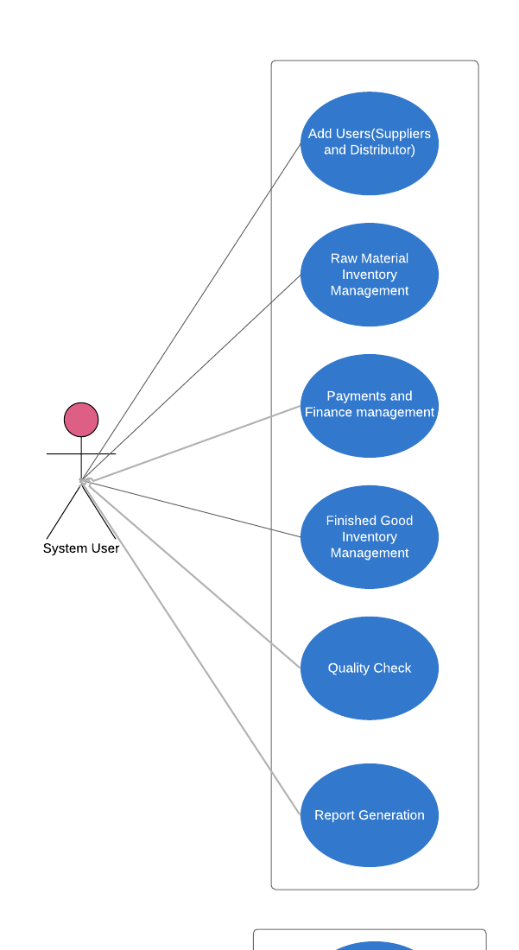
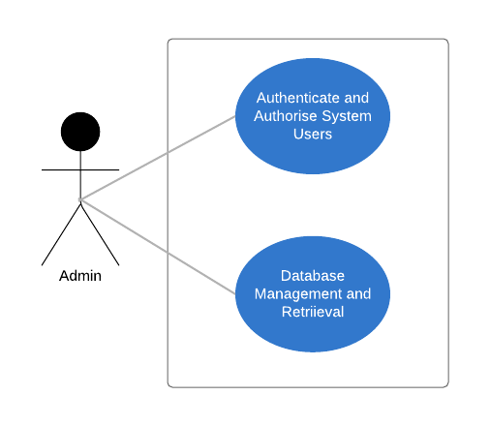
Use Case Diagram

Slide 6
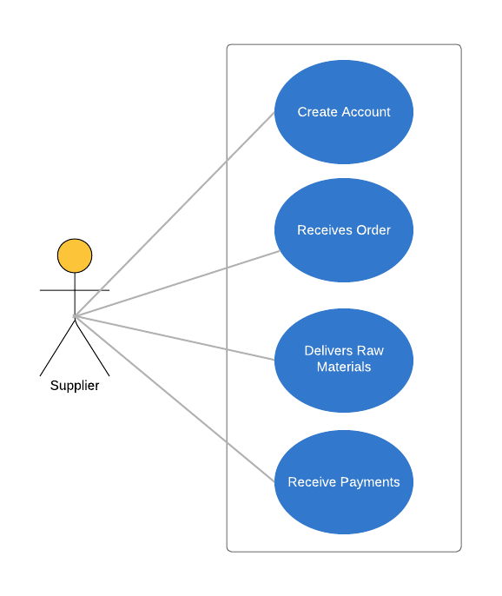
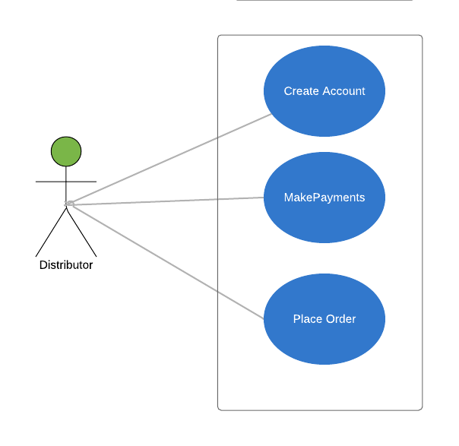
Use case diagram(contd.)

Slide 7
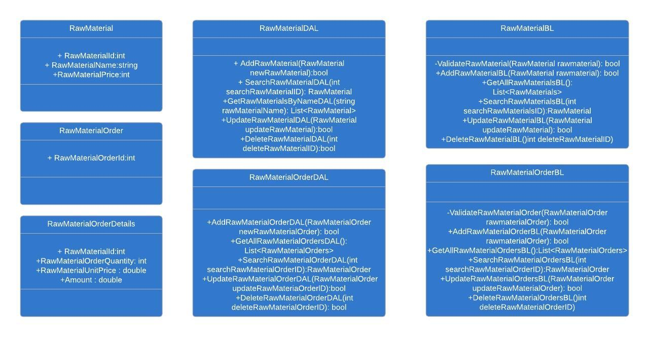
Class Diagram

Slide 8
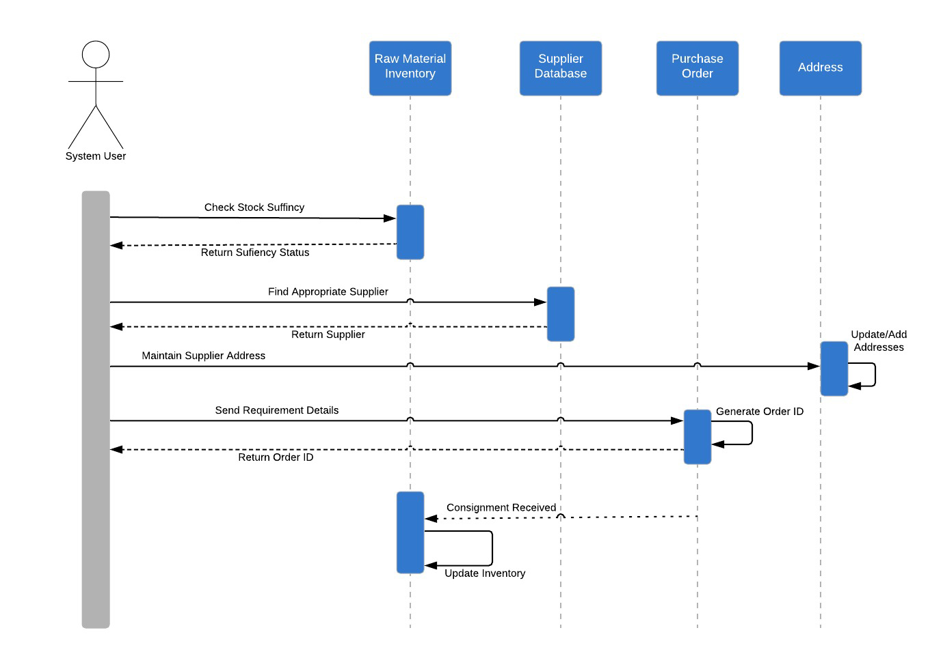
Sequence Diagram: Raw Material Order

Slide 9
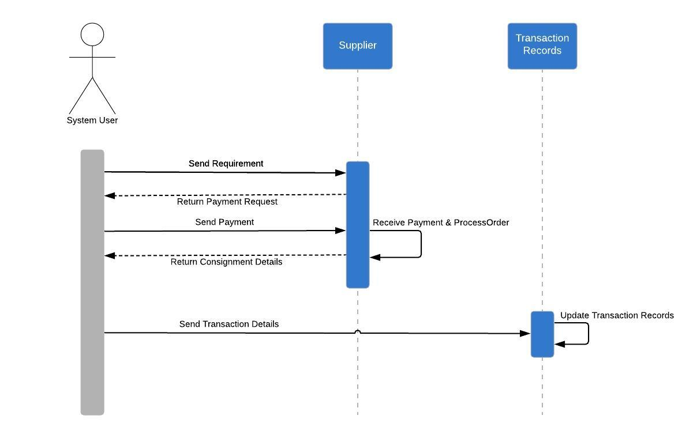
Sequence Diagram: Order Payment

Slide 10
Thank You.

